Slide 1


Slide 2
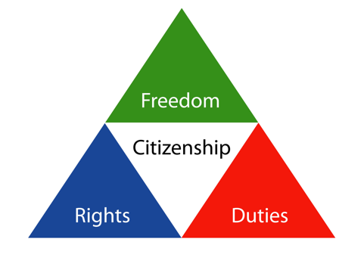


Slide 3
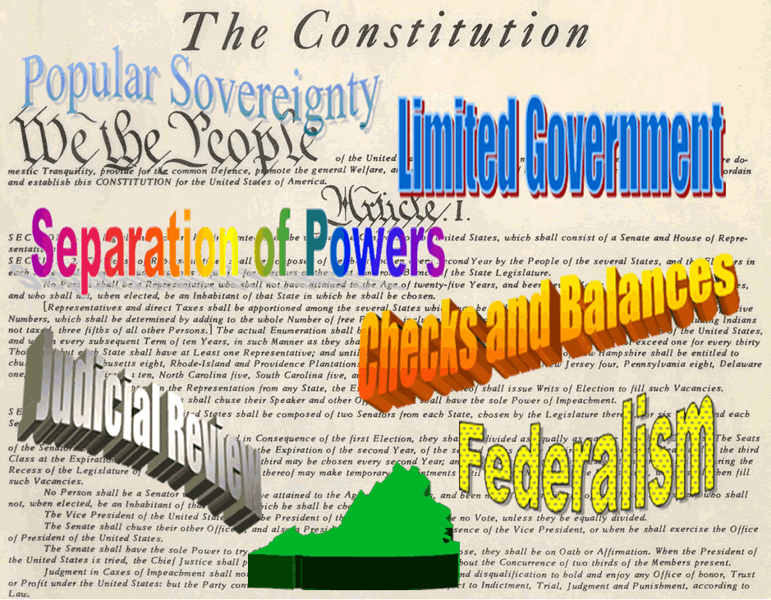

Slide 4


Slide 5
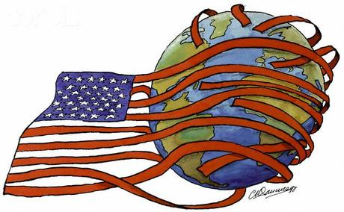
Foreign Policy

Slide 6


Slide 7

Immigration and Migration

Slide 8


Slide 9


Slide 10

Reform Movements

Slide 11
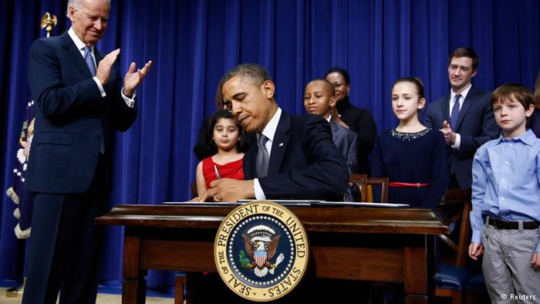
Presidential Actions

Slide 12



Slide 13
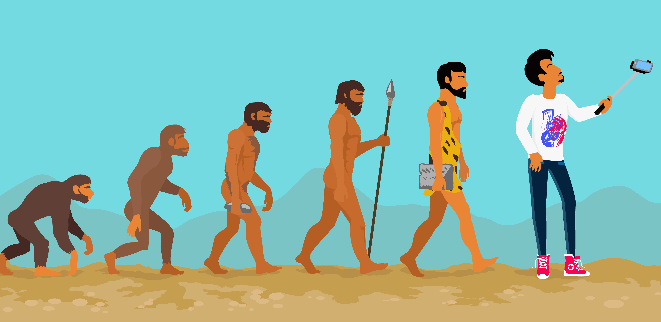
Science and Technology

Slide 14
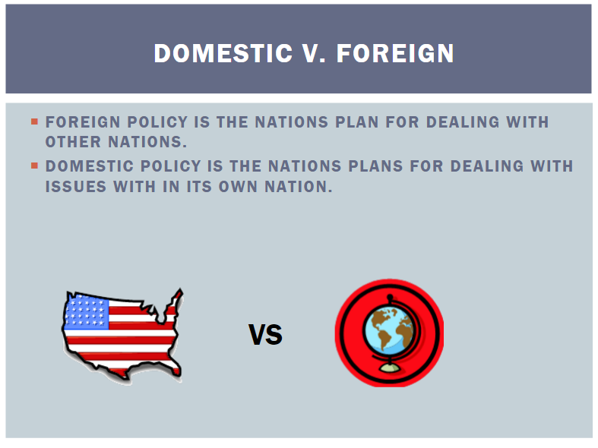

Slide 15
U.S. History Themes

